Slide 1
Representation learning of time series data with different model architectures
①
②
③
Autoformer: Decomposition Transformers with Auto-Correlation for Long-Term Series Forecasting
Informer: Beyond Efficient Transformer for Long Sequence Time-Series Forecasting
Are Transformers Effective for Time Series Forecasting
④
⑤
A TIME SERIES IS WORTH 64 WORDS:
LONG-TERM FORECASTING WITH TRANSFORMERS
PETformer: Long-term Time Series Forecasting Via Placeholder-enhanced Transformer
CPS Computational Learning Laboratory
1

Slide 2
Periodic signal
②
Non periodic signal
①
Autoformer: Decomposition Transformers with Auto-Correlation for Long-Term Series Forecasting
Informer: Beyond Efficient Transformer for Long Sequence Time-Series Forecasting
Transformer
③
Are Transformers Effective for Time Series Forecasting
Periodic signal
Linear
④
⑤
A TIME SERIES IS WORTH 64 WORDS:
LONG-TERM FORECASTING WITH TRANSFORMERS
PETformer: Long-term Time Series Forecasting Via Placeholder-enhanced Transformer
Transformer
Notes:
PETformer数据集：ETT(ETTh1, ETTh2, ETTh3, ETTh4)、Electricity、ILI、Weather、Traffic
PatchTST数据集：Weather、Traffic、Electricity、ILI、ETT(ETTh1, ETTh2, ETTh3, ETTh4)
Dlinear数据集：ETT(ETTh1, ETTh2, ETTh3, ETTh4)、Traffic、Electricity、Weather、ILI、ExchangeRate
Informer数据集：ETT(ETTh1, ETTh2)、ECL、Weather
Autoformer数据集：ETT、Electricity、Exchange、Traffic、Weather、ILI

Slide 3

Paper 1
Autoformer: Decomposition Transformers with Auto-Correlation for Long-Term Series Forecasting
Haixu Wu, Jiehui Xu, Jianmin Wang, Mingsheng Long
Published in: 35th Conference on Neural Information Processing Systems (NeurIPS 2021)
Published Time: 2021
CPS Computational Learning Laboratory
3
Notes:
这篇论文结合了可变处理时间（VPT），重点研究了在动态和不确定条件下优化完工时间解决FJSP

Slide 4
01
Problem Description
02
Method Design
03
Experiment Results
Contents
04
Conclusion
CPS Computational Learning Laboratory
4
Notes:
主要分为以下四个部分

Slide 5
01
Problem Description
02
Method Design
03
Experiment Results
Contents
04
Conclusion
CPS Computational Learning Laboratory
5
Notes:
首先是问题描述

Slide 6
Problem Description
Demand background
Extending the forecasting time is a critical demand for real applications, such as extreme weather early warning and long-term energy consumption planning. Transformers obtain great advantage in modeling long-term dependencies for sequential data.
Challenge (Why is long-term forecasting difficult?)
1. It is unreliable to discover the temporal dependencies directly from the long-term time series because the dependencies can be obscured by entangled temporal patterns.
2. Canonical Transformers with self-attention mechanisms are computationally prohibitive for long-term forecasting because of the quadratic complexity of sequence length.
Previous method
Previous Transformer-based forecasting models mainly focus on improving self-attention to a sparse version. While performance is significantly improved, these models still utilize the point-wise representation aggregation. Thus, in the process of efficiency improvement, they will sacrifice the information utilization because of the sparse point-wise connections, resulting in a bottleneck for long-term forecasting of time series.
CPS Computational Learning Laboratory
6

Slide 7
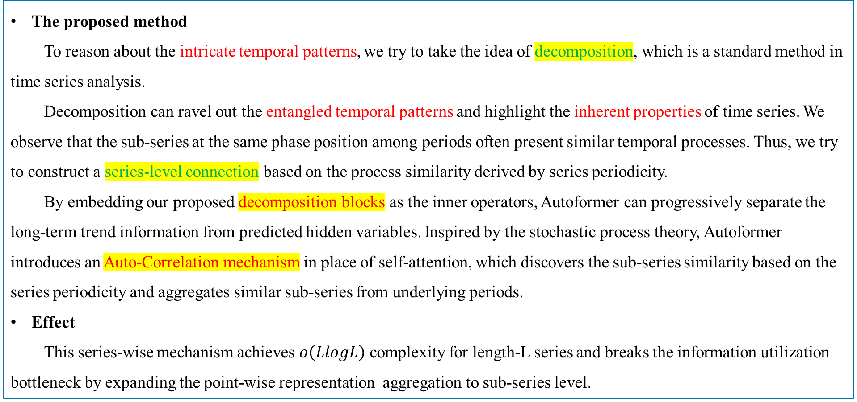
Problem Description
The proposed method
To reason about the intricate temporal patterns, we try to take the idea of decomposition, which is a standard method in time series analysis.
Decomposition can ravel out the entangled temporal patterns and highlight the inherent properties of time series. We observe that the sub-series at the same phase position among periods often present similar temporal processes. Thus, we try to construct a series-level connection based on the process similarity derived by series periodicity.
By embedding our proposed decomposition blocks as the inner operators, Autoformer can progressively separate the long-term trend information from predicted hidden variables. Inspired by the stochastic process theory, Autoformer introduces an Auto-Correlation mechanism in place of self-attention, which discovers the sub-series similarity based on the series periodicity and aggregates similar sub-series from underlying periods.
Effect
This series-wise mechanism achieves $ο\left(LlogL\right)$ complexity for length-L series and breaks the information utilization bottleneck by expanding the point-wise representation aggregation to sub-series level.
CPS Computational Learning Laboratory
7

Slide 8
01
Problem Description
02
Method Design
03
Experiment Results
Contents
04
Conclusion
CPS Computational Learning Laboratory
8

Slide 9
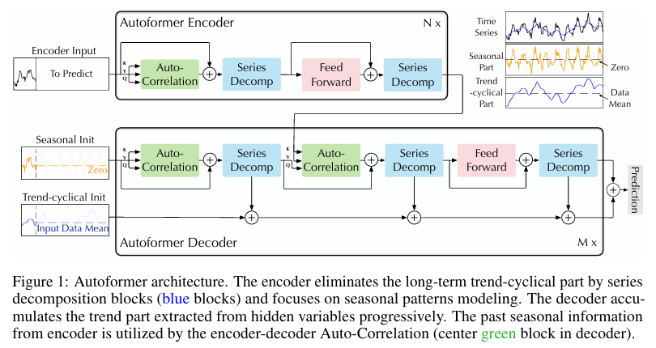
Method Design
CPS Computational Learning Laboratory
9

Slide 10
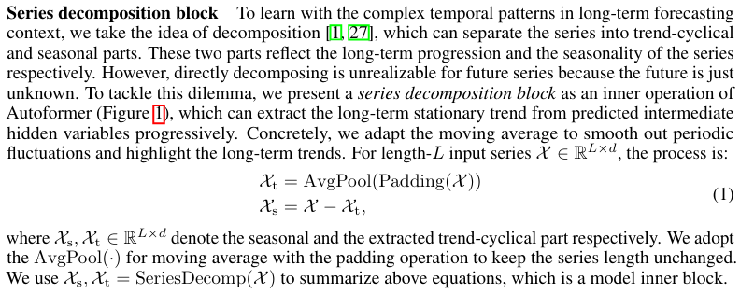
Method Design
Decomposition Architecture
To learn with the complex temporal patterns in long-term forecasting context, we take the idea of decomposition, which can separate the series into trend-cyclical and seasonal parts.
CPS Computational Learning Laboratory
10

Slide 11
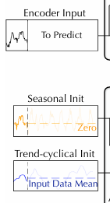
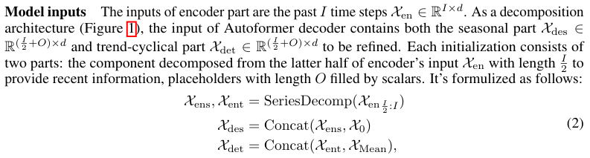

Method Design
CPS Computational Learning Laboratory
11

Slide 12
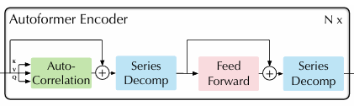
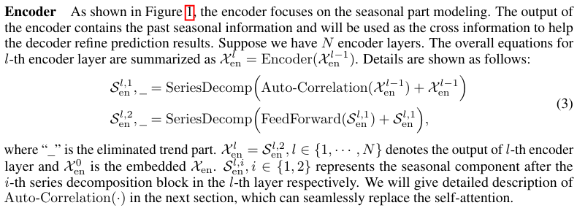

Method Design
CPS Computational Learning Laboratory
12

Slide 13
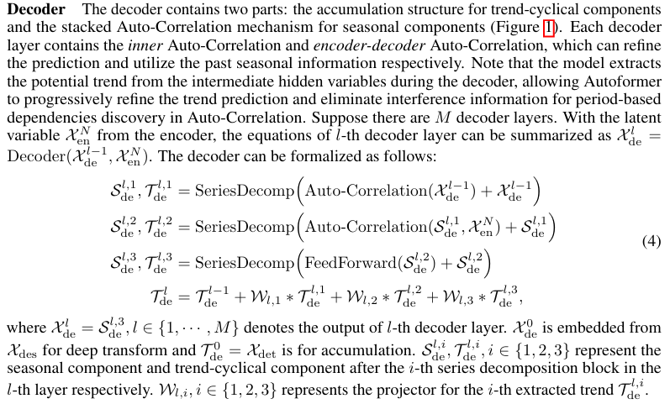

Method Design
CPS Computational Learning Laboratory
13

Slide 14
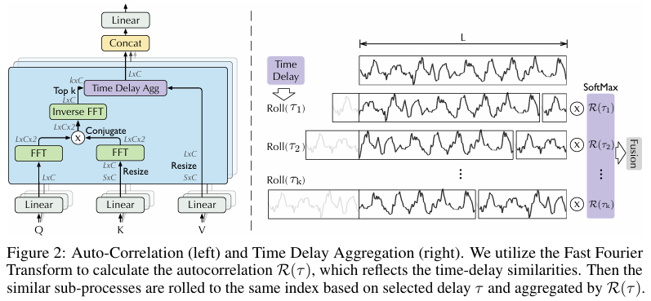
Method Design
Auto-Correlation Mechanism
CPS Computational Learning Laboratory
14

Slide 15
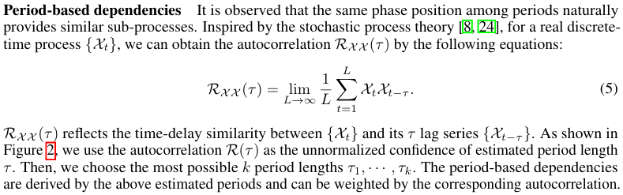
Method Design
CPS Computational Learning Laboratory
15

Slide 16
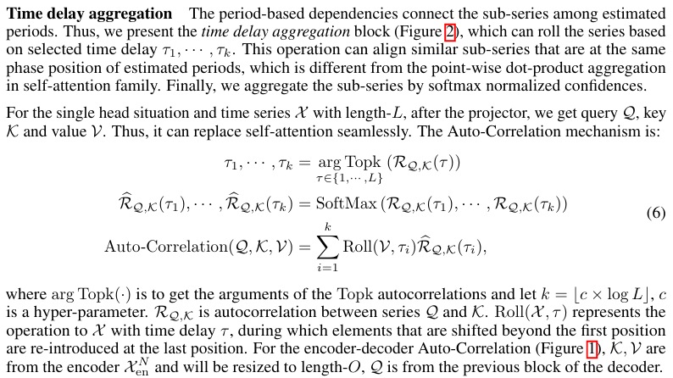
Method Design
CPS Computational Learning Laboratory
16

Slide 17
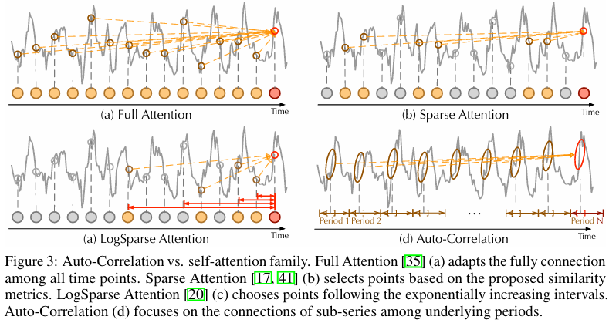
Method Design
CPS Computational Learning Laboratory
17

Slide 18
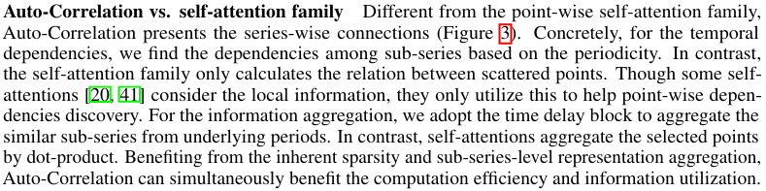
Method Design
CPS Computational Learning Laboratory
18

Slide 19
01
Problem Description
02
Method Design
03
Experiment Results
Contents
04
Conclusion
CPS Computational Learning Laboratory
19

Slide 20
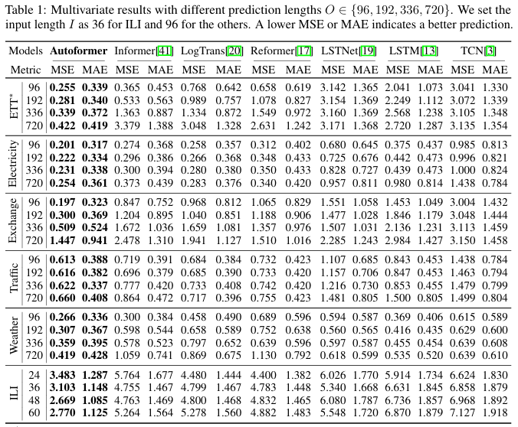



Experiment Results
Multivariate results
CPS Computational Learning Laboratory
20

Slide 21
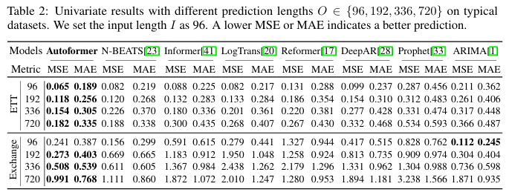
Experiment Results
Univariate results
CPS Computational Learning Laboratory
21

Slide 22
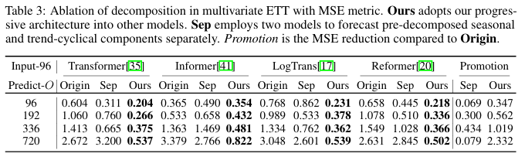
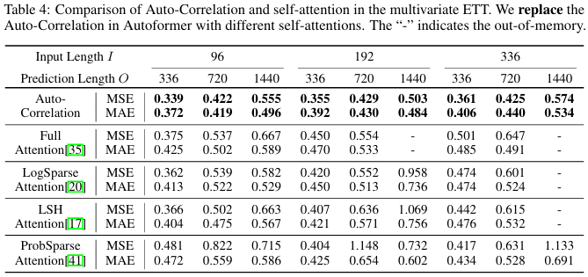


Experiment Results
Ablation studies
CPS Computational Learning Laboratory
22

Slide 23
01
Problem Description
02
Method Design
03
Experiment Results
Contents
04
Conclusion
CPS Computational Learning Laboratory
23
CPS Computational Learning Laboratory
2
18

Slide 24
Conclusion
①
Breaking away from conventional methods that treat sequence decomposition as a preprocessing step, we propose a novel Deep Decomposition Architecture capable of disentangling complex temporal patterns into more predictable components.
②
Based on stochastic process theory, we introduce an Auto-Correlation Mechanism (ACM) that replaces the conventional point-wise attention mechanism. ACM enables series-wise connectivity and achieves O(log L) complexity, effectively overcoming information bottlenecks.
CPS Computational Learning Laboratory
24
Notes:
本文介绍了一种考虑处理时间可变性（VPT）的DFJSP模型，并提出了一种使用PPO的两阶段动态调度框架。实验结果表明，与遗传算法、蚁群算法和单一调度规则相比，PPO具有更优的性能和泛化能力，最大优化率为94.29%。

Slide 25
Paper 2
Informer: Beyond Efficient Transformer for Long Sequence Time-Series Forecasting
Haoyi Zhou, Shanghang Zhang, Jieqi Peng, Shuai Zhang, Jianxin Li, Hui Xiong, and Wancai Zhang
Publish Journal: AAAI Conference on Artificial Intelligence (2021)
Published Time: 28 Mar 2021
CPS Computational Learning Laboratory
25
Notes:
基于深度强化学习的柔性作业车间动态调度

Slide 26
01
Problem Description
02
Method Design
03
Experiment Results
Contents
04
Conclusion
CPS Computational Learning Laboratory
26
Notes:
主要分为以下四个部分

Slide 27
01
Problem Description
02
Method Design
03
Experiment Results
Contents
04
Conclusion
CPS Computational Learning Laboratory
27
Notes:
首先是问题描述

Slide 28
Problem Description
Long sequence time-series forecasting (LSTF)
LSTF demands a high prediction capacity of the model, which is the ability to capture precise long-range dependency coupling between output and input efficiently. Recent studies have shown the potential of Transformer to increase the prediction capacity.
Challenge (Why can't Transformer be directly applied to LSTF?)
Quadratic time complexity, high memory usage, and inherent limitation of the encoder-decoder architecture.
Method
1. A ProbSparse self-attention mechanism, which achieves 𝜊(𝐿𝑙𝑜𝑔𝐿) in time complexity and memory usage, and has comparable performance on sequences’ dependency alignment.
2. The self-attention distilling highlights dominating attention by halving cascading layer input, and efficiently handles extreme long input sequences.
3. The generative style decoder predicts the long time-series sequences at one forward operation, which improves the inference speed.
CPS Computational Learning Laboratory
28
Notes:
这篇文章针对长序列时间预测任务提出了一种基于Tansformer的兼顾预测精度和运行效率的方法。作者认为将基础的Transformer模型应用于长序列时间预测任务具有以下三个挑战：一是二次计算复杂度；二是高内存占用；三是编码器解码器架构局限性导致的长序列预测低效问题。针对以上三个挑战，作者提出了三个解决方法：一是用ProbSparse self-attention mechanism代替标准自注意力机制，降低计算复杂度，减少内存占用；二是利用self-attention distilling减少网络参数量；三是提出generative style decoder一步得到所有预测结果。接下来，具体介绍Informer方法。

Slide 29
01
Problem Description
02
Method Design
03
Experiment Results
Contents
04
Conclusion
CPS Computational Learning Laboratory
29
Notes:
研究现状

Slide 30
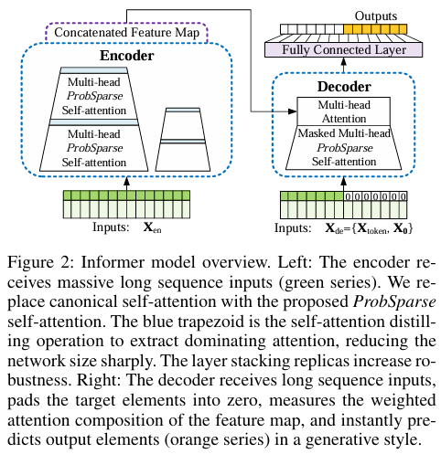
Method Design
Red cycle: self-attention → ProbSparse Self-attention, reduce complexity and memory usage.
Blue cycle: Self-attention Distilling, reduce network parameters.
Yellow cycle: Layer stacking replicas, improve robustness.
Green cycle: Decoder, the target part is padded with 0.
Purple cycle: Generative style, the predicted target, generated in one step rather than dynamic decoding.
CPS Computational Learning Laboratory
30
Notes:
这张图展示的是Informer模型的整体架构。下面对Informer模型的架构进行简单的解释。左边为编码器，其编码过程为：编码器接收长序列输入（绿色部分），通过ProbSparse自注意力模块和自注意力蒸馏模块，得到特征表示。右边为解码器，解码过程为：解码器接收长序列输入（预测目标部分设置为0），通过多头注意力与编码特征进行交互，最后一次性直接预测输出目标部分（橙黄色部分）。

Slide 31
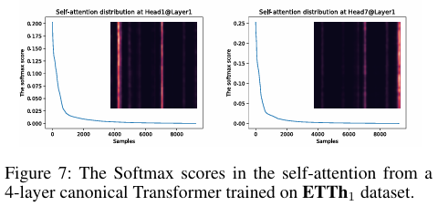
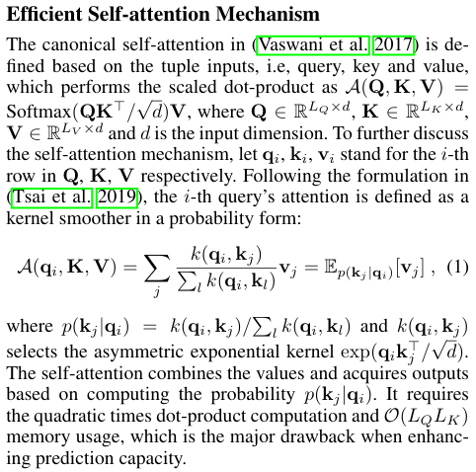
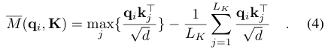




Method Design - ProbSparse Self-attention
The blue line in Fig.(7) forms a long tail distribution, i.e.a few dot-product pairs contribute to the major attention and others can be ignored.
O(LlnL)
CPS Computational Learning Laboratory
31
Notes:
该文作者通过实验验证了经典自注意力机制存在稀疏性，即自注意力特征图的长尾分布现象。具体为如下图所示，较少的点积贡献了绝大部分的注意力得分，也就是说其余部分的成对点积可以忽略。

Slide 32
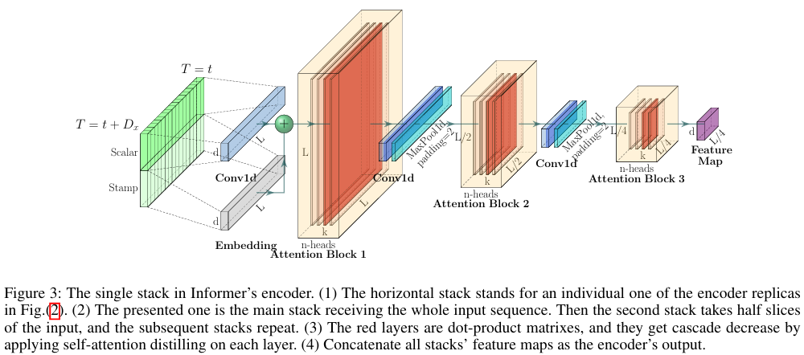
Method Design
CPS Computational Learning Laboratory
32

Slide 33
01
Problem Description
02
Method Design
03
Experiment Results
Contents
04
Conclusion
CPS Computational Learning Laboratory
33

Slide 34
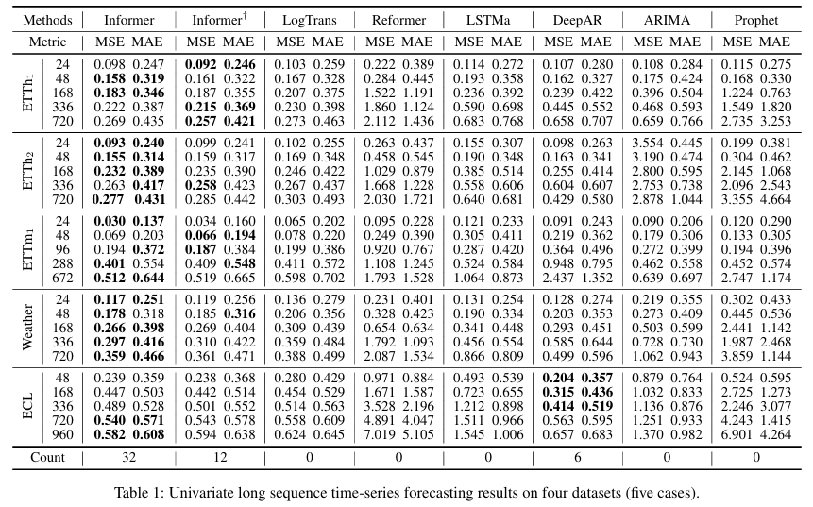

Experiment Results
Univariate time-series
forecasting
CPS Computational Learning Laboratory
34
Notes:
ETTh1和ETTh2主要区别在于时间粒度和数据范围。

Slide 35
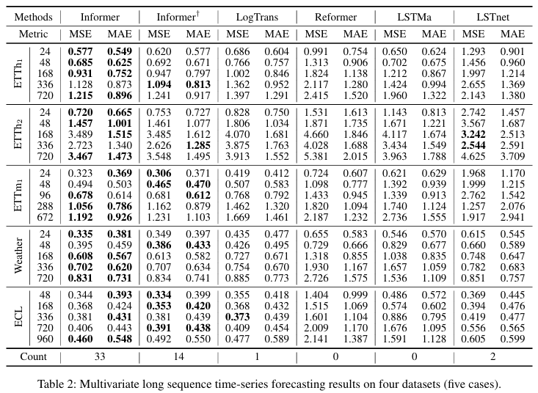

Experiment Results
Multivariate time-series
forecasting
CPS Computational Learning Laboratory
35

Slide 36
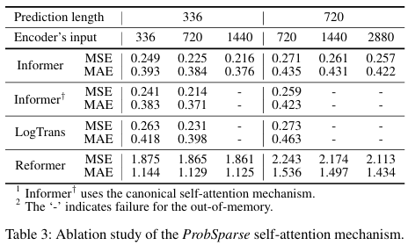
Experiment Results
Ablation study
CPS Computational Learning Laboratory
36

Slide 37
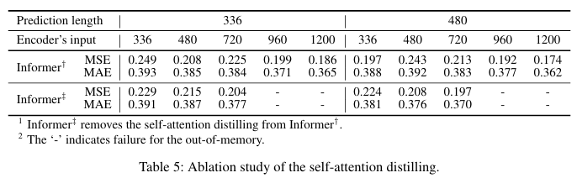
Experiment Results
Ablation study
CPS Computational Learning Laboratory
37

Slide 38
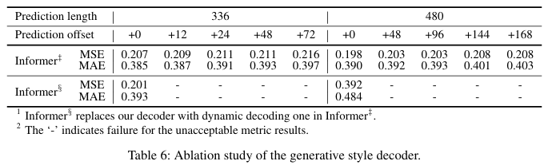
Experiment Results
Ablation study
CPS Computational Learning Laboratory
38

Slide 39
01
Problem Description
02
Method Design
03
Experiment Results
Contents
04
Conclusion
CPS Computational Learning Laboratory
39
CPS Computational Learning Laboratory
2
18

Slide 40
Conclusion
①
Through ProbSparse Attention, the model computes only the Top-u most significant Query-Key pairs, thereby reducing the complexity from O(L²) to O(L log L).
②
Through the Distilling operation, we employ convolution and downsampling to compress attention layers, thereby reducing redundancy.
②
By leveraging a Generative Decoder, the model predicts multi-step outputs in a single forward pass, effectively preventing error accumulation across time steps.
CPS Computational Learning Laboratory
40

Slide 41
Paper 3
Are Transformers Effective for Time Series Forecasting?
Ailing Zeng, Muxi Chen , Lei Zhang, and Qiang Xu
Published in: Proceedings of the AAAI Conference on Artificial Intelligence
Published Time: 2023
CPS Computational Learning Laboratory
41

Slide 42
01
Problem Description
02
Method Design
03
Experiment Results
Contents
04
Conclusion
CPS Computational Learning Laboratory
42
Notes:
主要分为以下四个部分

Slide 43
01
Problem Description
02
Method Design
03
Experiment Results
Contents
04
Conclusion
CPS Computational Learning Laboratory
43
Notes:
首先是问题描述

Slide 44
Problem Description
Motivation
We hypothesize that long-term forecasting is only feasible for those time series with a relatively clear trend and periodicity. As linear models can already extract such information, we introduce a set of embarrassingly simple models named LTSF-Linear as a newbaseline for comparison.
Challenge
In time series modeling, we are to extract the temporal relations in an ordered set of continuous points. The order itself plays the most crucial role in time series data. The nature of the permutation-invariant self-attention mechanism inevitably results in temporal information loss.
Method
LTSF-Linear regresses historical time series with a one-layer linear model to forecast future time series directly.
CPS Computational Learning Laboratory
44

Slide 45
01
Problem Description
02
Method Design
03
Experiment Results
Contents
04
Conclusion
CPS Computational Learning Laboratory
45
Notes:
研究现状

Slide 46
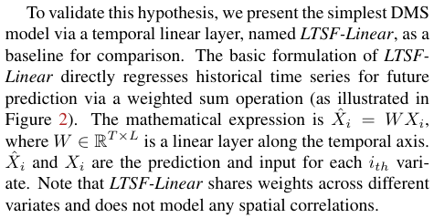
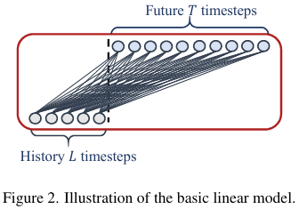
Method Design
Hypothesis
In the experiments of existing Transformer-based LTSF solutions, all the compared (non-Transformer) baselines are IMS forecasting techniques, which are known to suffer from significant error accumulation effects. We hypothesize that the performance improvements in these works are largely due to the DMS strategy used in them.
CPS Computational Learning Laboratory
46

Slide 47
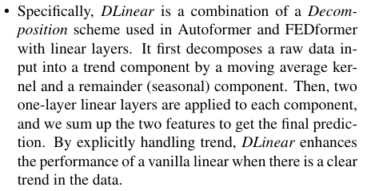
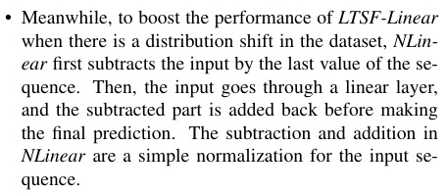
Method Design
CPS Computational Learning Laboratory
47

Slide 48
01
Problem Description
02
Method Design
03
Experiment Results
Contents
04
Conclusion
CPS Computational Learning Laboratory
48

Slide 49
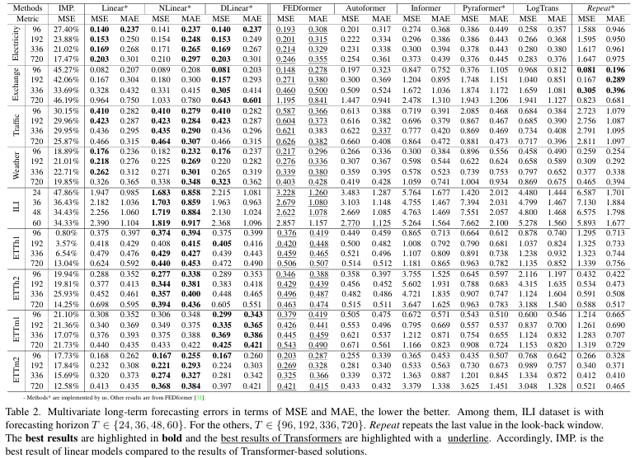



Experiment Results
Quantitative results
CPS Computational Learning Laboratory
49

Slide 50
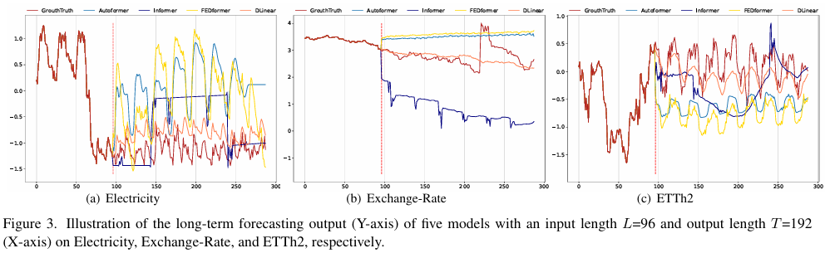
Experiment Results
Qualitative results
These datasets have different temporal patterns. When the input length is 96 steps, and the output horizon is 336 steps, Transformers fail to capture the scale and bias of the future data on Electricity and ETTh2. Moreover, they can hardly predict a proper trend on aperiodic data such as Exchange-Rate. These phenomena further indicate the inadequacy of existing Transformer-based solutions for the LTSF task.
CPS Computational Learning Laboratory
50

Slide 51
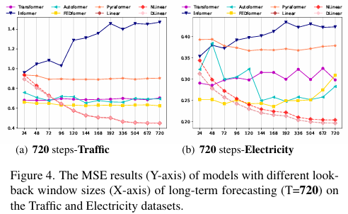
Experiment Results
Can existing LTSF-Transformers extract temporal relations well from longer input sequences?
CPS Computational Learning Laboratory
51

Slide 52
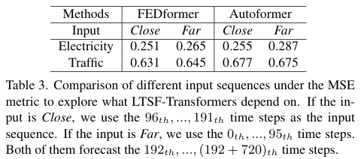
Experiment Results
What can be learned for long-term forecasting?
While the temporal dynamics in the look-back window significantly impact the forecasting accuracy of short-term time series forecasting, we hypothesize that long-term forecasting depends on whether models can capture the trend and periodicity well only. That is, the farther the forecasting horizon, the less impact thelook-back window itself has.
CPS Computational Learning Laboratory
52

Slide 53
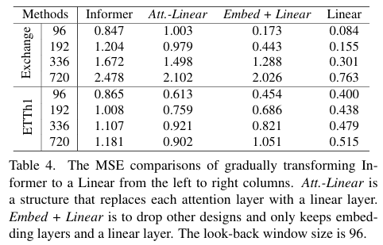
Experiment Results
Are the self-attention scheme effective for LTSF?
CPS Computational Learning Laboratory
53

Slide 54
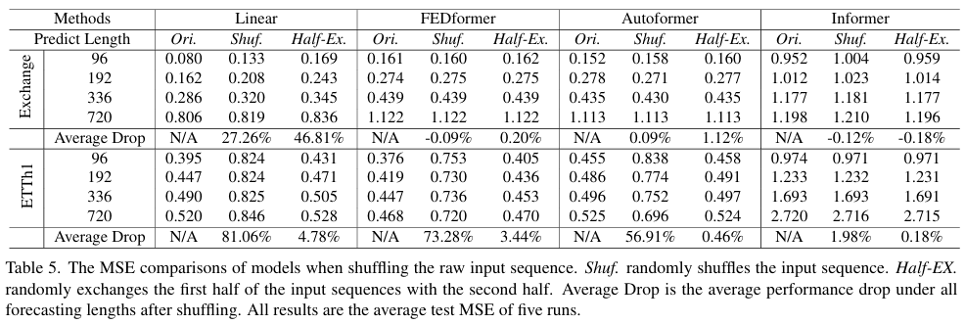
Experiment Results
Can existing LTSF-Transformers preserve temporal order well?
CPS Computational Learning Laboratory
54

Slide 55
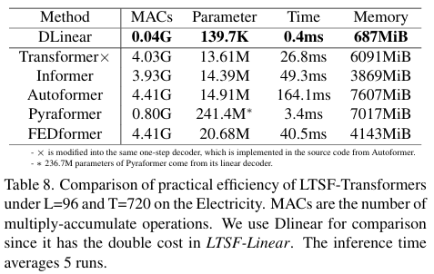
Experiment Results
Is efficiency really a top-level priority?
CPS Computational Learning Laboratory
55

Slide 56
01
Problem Description
02
Method Design
03
Experiment Results
Contents
04
Conclusion
CPS Computational Learning Laboratory
56
CPS Computational Learning Laboratory
2
18

Slide 57
Conclusion and future work
This work questions the effectiveness of emerging favored Transformer-based solutions for the long-term series forecasting problem. Our contributions do not come from proposing a linear model but rather from demonstrating why LTSF-Transformers are not as effective as claimed.
LTSF-Linear has a limited model capacity. For example, the one-layer linear network is hard to capture the temporal dynamics caused by change points. However, LTSF-Linear serves a simple yet competitive baseline with strong interpretability for future research.
CPS Computational Learning Laboratory
57

Slide 58
Paper 4
A TIME SERIES IS WORTH 64 WORDS:
LONG-TERM FORECASTING WITH TRANSFORMERS
Yuqi Nie, Nam H. Nguyen, Phanwadee Sinthong, and Jayant Kalagnanam
Published in: ICLR 2023
Published Time: 5 Mar 2023
CPS Computational Learning Laboratory
58
Notes:
一种基于分层深度强化学习的自适应多目标多任务调度方法

Slide 59
01
Problem Description
02
Method Design
03
Experiment Results
Contents
04
Conclusion
CPS Computational Learning Laboratory
59
Notes:
主要分为以下四个部分

Slide 60
01
Problem Description
02
Method Design
03
Experiment Results
Contents
04
Conclusion
CPS Computational Learning Laboratory
60
Notes:
首先是问题描述

Slide 61
Problem Description
We propose an efficient design of Transformer-based models named channel-independent patch time series Transformer (PatchTST) for multivariate time series forecasting and self-supervised representation learning.
Motivation
Regardless of the complicated design of Transformer-based models, it is shown in the recent paper that a very simple linear model can outperform all of the previous models on a variety of common benchmarks and it challenges the usefulness of Transformer for time series forecasting.
Method
PatchTST based on two key components: (i) segmentation of time series into subseries-level patches which are served as input tokens to Transformer; (ii) channel-independence where each channel contains a single univariate time series that shares the same embedding and Transformer weights across all the series.
CPS Computational Learning Laboratory
61

Slide 62
01
Problem Description
02
Method Design
03
Experiment Results
Contents
04
Conclusion
CPS Computational Learning Laboratory
62
Notes:
研究现状

Slide 63
Method Design
Patching
Time series forecasting aims to understand the correlation between data in each different time steps. However, a single time step does not have semantic meaning like a word in a sentence, thus extracting local semantic information is essential in analyzing their connections. Most of the previous works only use point-wise input tokens, or just a handcrafted information from series. In contrast, we enhance the locality and capture comprehensive semantic information that is not available in point-level by aggregating time steps into subseries-level patches.
Channel-independence
A multivariate time series is a multi-channel signal, and each Transformer input token can be represented by data from either a single channel or multiple channels. Depending onthe design of input tokens, different variants of the Transformer architecture have been proposed. Channel-mixing refers to the latter case where the input token takes the vector of all time series features and projects it to the embedding space to mix information. On the other hand, channel-independence means that each input token only contains information from a single channel. This was proven to work well with CNN and linear models, but hasn’t been applied to Transformer-based models yet.
CPS Computational Learning Laboratory
63

Slide 64
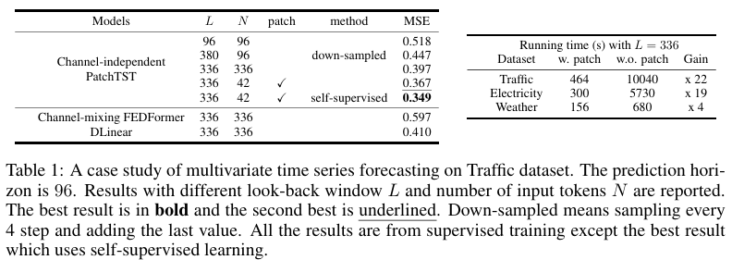
Method Design
CPS Computational Learning Laboratory
64

Slide 65
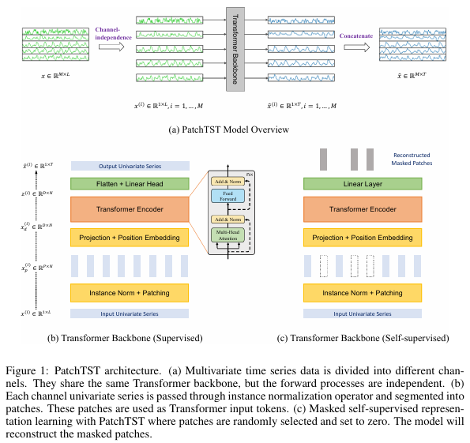
Method Design
CPS Computational Learning Laboratory
65

Slide 66
01
Problem Description
02
Method Design
03
Experiment Results
Contents
04
Conclusion
CPS Computational Learning Laboratory
66

Slide 67
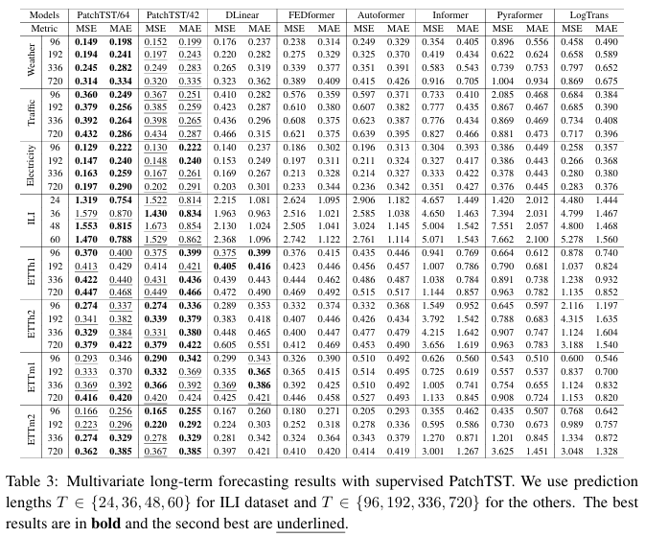


Experiment Results
LONG-TERM TIME SERIES FORECASTING
CPS Computational Learning Laboratory
67

Slide 68
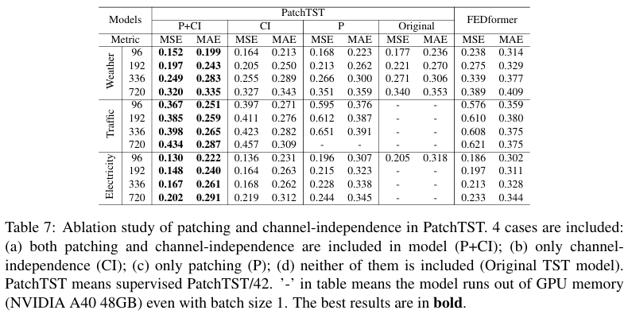
Experiment Results
ABLATION STUDY
CPS Computational Learning Laboratory
68

Slide 69
01
Problem Description
02
Method Design
03
Experiment Results
Contents
04
Conclusion
CPS Computational Learning Laboratory
69
CPS Computational Learning Laboratory
2
18

Slide 70
Conclusion and future work
Contributions
Patching is simple but proven to be an effective operator that can be transferred easily to other models.
Channel-independence can be further exploited to incorporate the correlation between different channels.
CPS Computational Learning Laboratory
70

Slide 71
Paper 5
PETformer: Long-term Time Series Forecasting Via Placeholder-enhanced Transformer
Shengsheng Lin, Weiwei Lin, Wentai Wu, Songbo Wang and Yongxiang Wang
Published in: ICLR 2024
Published Time: 2024
CPS Computational Learning Laboratory
71

Slide 72
01
Problem Description
02
Method Design
03
Experiment Results
Contents
04
Conclusion
CPS Computational Learning Laboratory
72
Notes:
主要分为以下四个部分

Slide 73
01
Problem Description
02
Method Design
03
Experiment Results
Contents
04
Conclusion
CPS Computational Learning Laboratory
73
Notes:
首先是问题描述

Slide 74
Problem Description
Motivation
Our work demonstrates that Transformer still possesses powerful capabilities in LTSF.
Challenge
temporal continuity, information density, multi-channel relationships
Method
We propose three key designs- PET, LSD, and MSI- to address these challenges and ultimately introduce a new solution
called PETformer.
CPS Computational Learning Laboratory
74

Slide 75
01
Problem Description
02
Method Design
03
Experiment Results
Contents
04
Conclusion
CPS Computational Learning Laboratory
75
Notes:
研究现状

Slide 76
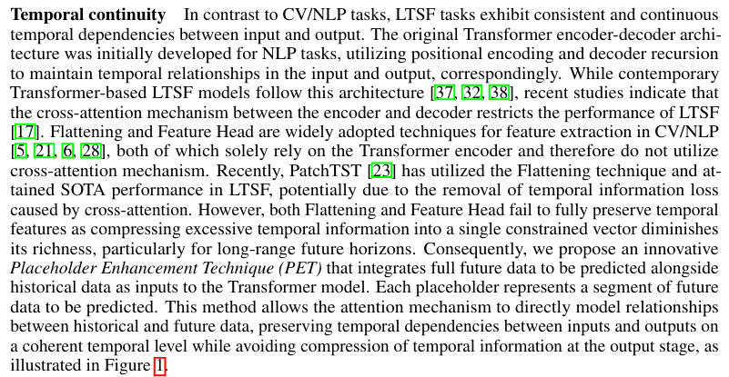
Method Design
CPS Computational Learning Laboratory
76
Notes:
文章主要从两个角度探索了Transformer如何应用于时间序列预测，一方面是Transformer的结构上，提出了Placeholder-enhanced结构；另一方面是在多变量关系建模上，探索了最有效的建模方式。
时序和NLP存在差异——时序每个节点并没有明确的含义，需要结合上下文信息才能体现出来；而每个NLP每个token有明确的语义含义。因此，文章中仍然沿用了PatchTST的方式，将时间序列分成多个patch，每个patch分别生成embedding。
与PatchTST的差别是，文中使用了更大的子序列长度，这样一方面可以提升运算效率，另一方面也让每个patch的语义信息更加丰富。

Slide 77
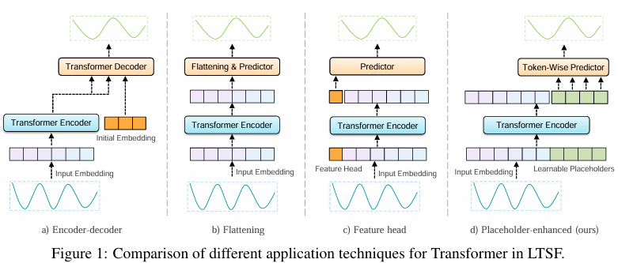
Method Design
CPS Computational Learning Laboratory
77
Notes:
在Transformer结构上，文章提出了PET方法。在原来的Encoder-Decoder结构中，预测序列和历史序列被分割成两个部分分别由Encoder和Decoder建模，再通过cross-attention建立联系。但是这个过程会使历史序列的信息出现损失，无法完美应用到Decoder中。
为了解决这个问题，文章采用PE的方式，在Decoder部分使用几个可学习的向量作为输入，不再区分Encoder和Decoder，而是拼接到历史序列的token上，一起输入到统一Transformer，让待预测部分更自然的获取历史序列信息。

Slide 78
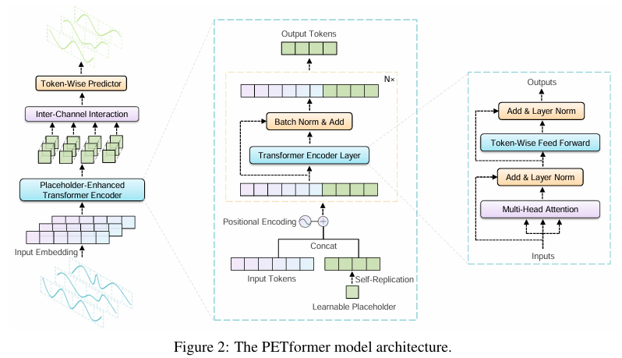
Method Design
CPS Computational Learning Laboratory
78

Slide 79

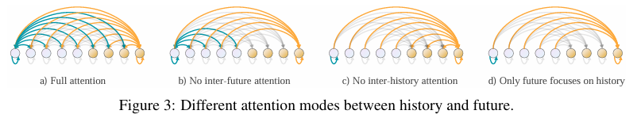
Method Design
CPS Computational Learning Laboratory
79

Slide 80
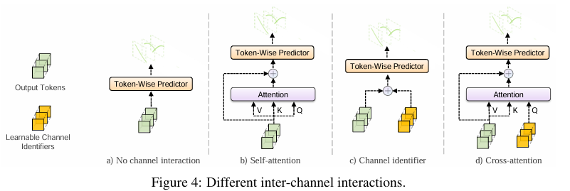
Method Design
Inter-channel interaction
CPS Computational Learning Laboratory
80

Slide 81
01
Problem Description
02
Method Design
03
Experiment Results
Contents
04
Conclusion
CPS Computational Learning Laboratory
81

Slide 82
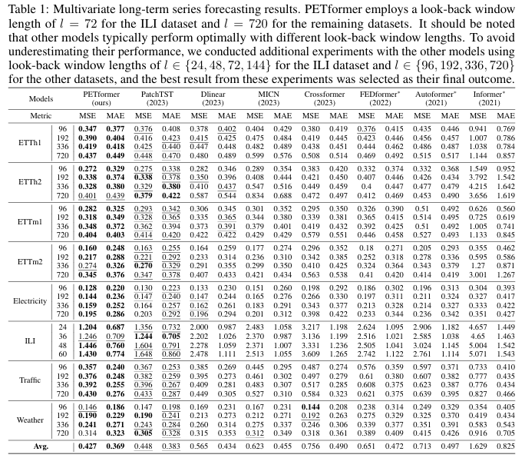
Experiment Results
Multivariate long-term
forecasting
CPS Computational Learning Laboratory
82

Slide 83
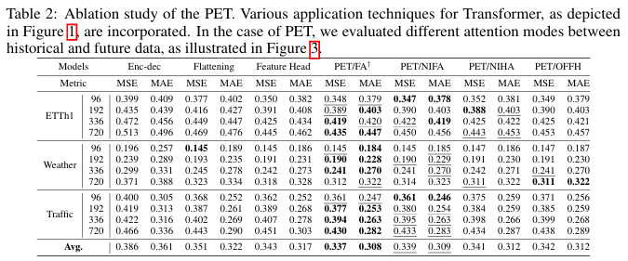
Experiment Results
Ablation study
CPS Computational Learning Laboratory
83

Slide 84
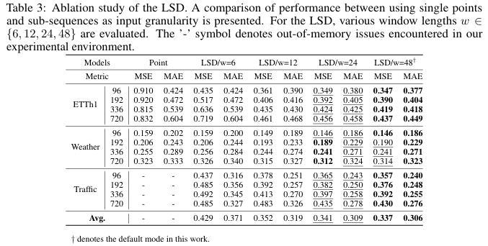
Experiment Results
Ablation study
CPS Computational Learning Laboratory
84

Slide 85

Experiment Results
Ablation study
CPS Computational Learning Laboratory
85

Slide 86
01
Problem Description
02
Method Design
03
Experiment Results
Contents
04
Conclusion
CPS Computational Learning Laboratory
86
CPS Computational Learning Laboratory
2
18

Slide 87
Conclusion
Contributions
The paper investigates how Transformers can be applied to time series forecasting from two perspectives: 1) enhancing Transformer architecture with a Placeholder-enhanced structure, and 2) exploring the most effective approaches for multivariate relationship modeling.
CPS Computational Learning Laboratory
87

Slide 88
Inspiration
Non-linear Relationship between Model Complexity and Performance.
Alignment of Data Characteristics with Modular Mechanisms.
CPS Computational Learning Laboratory
88

Slide 89
Thank you for listening

